Slide 1
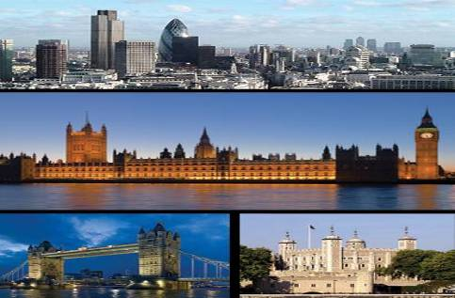
A Trip to London

Slide 2
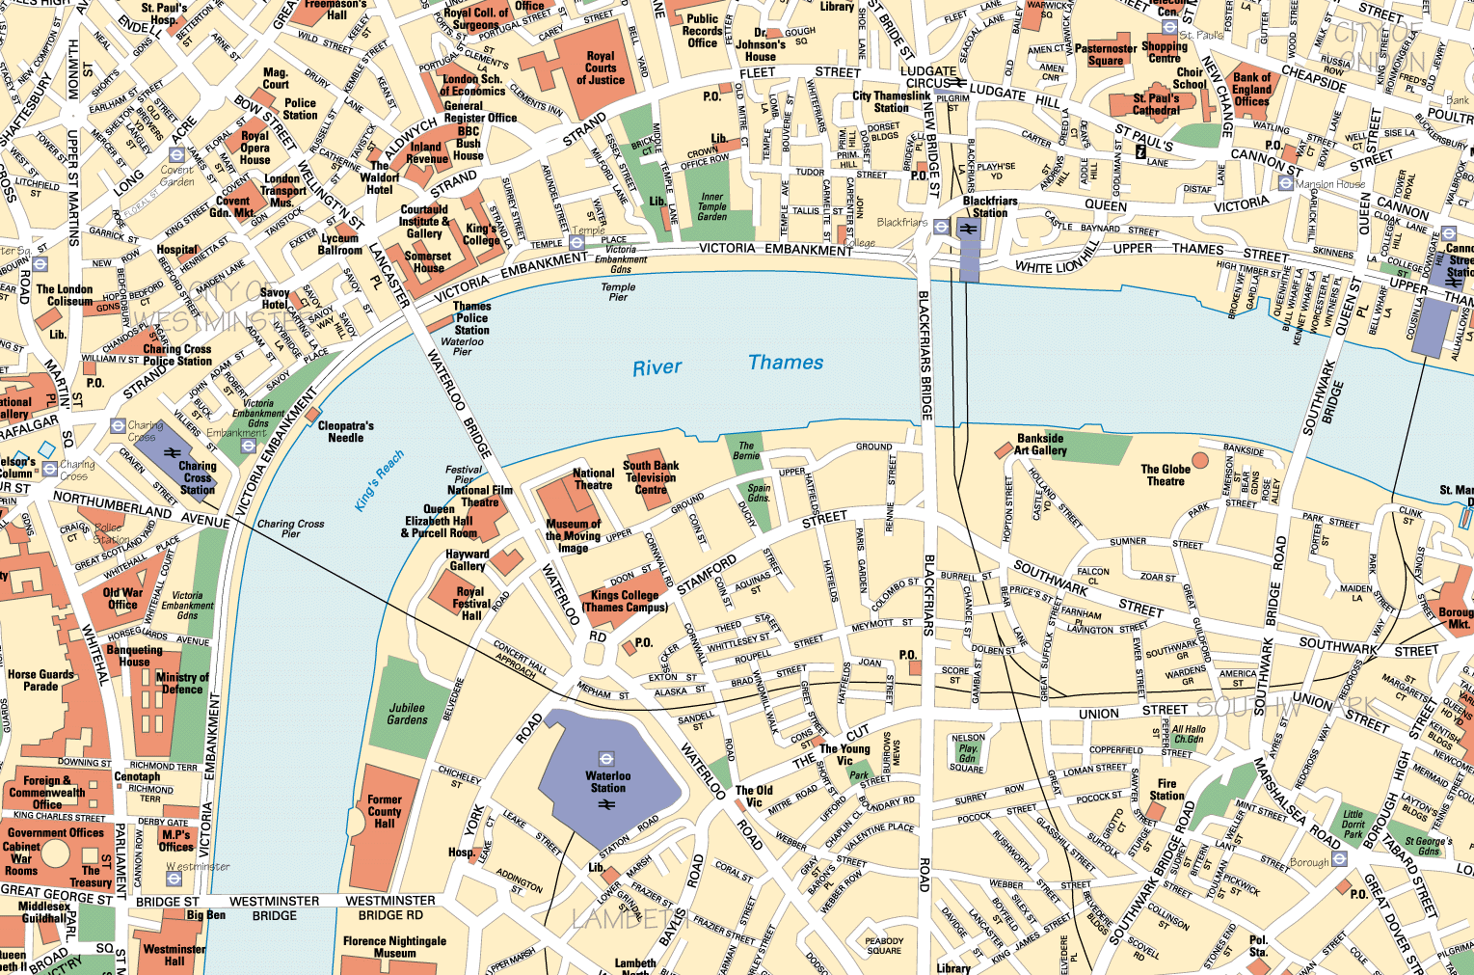
WELCOME TO LONDON

Slide 3
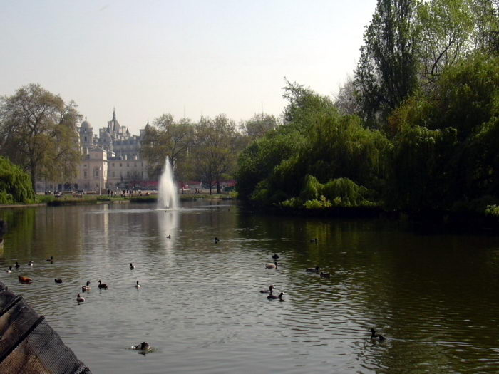
«London is one of the most beautiful and
interesting cities in the world.
It’s worth visiting!»

Slide 4
Listen to and pronounce the names of the places carefully
Trafalgar square
The Tower of London
The Houses of Parliament
Big Ben
Westminster Abbey
The Bloody Tower
The White Tower
Tower Bridge
Buckingham Palace

Slide 5
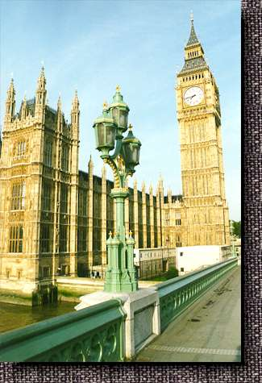
Big Ben
This is Big Ben. You can see the clock in its tower and hear the bells.
Big Ben is a really bell. You hear it every hour.

Slide 6
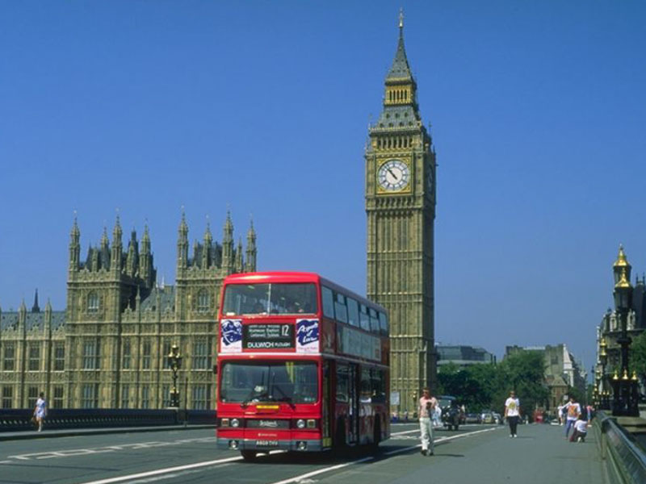
the houses of parliament
The famous clock Big Ben stands near the Houses of Parliament. The country’s leaders speak in the Houses of Parliament.

Slide 7
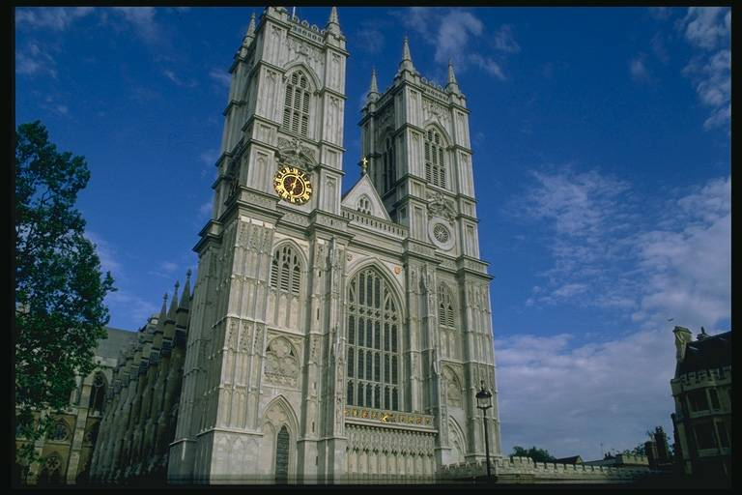
Westminster Abbey
Westminster Abbey is a church (церковь). Westminster Abbey is a symbol of England. It was built by King Edward in 1065.
The coronation of all British Kings and Queens take place in Westminster Abbey. Some famous English people are also buried [berid] (похоронены) here.

Slide 8
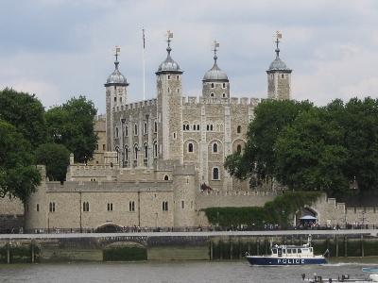
The tower of London
This is the Tower of London. The Tower is very old. It has a long and cruel history. The White Tower is the oldest part of the Tower of London. The Bloody Tower is near the river. It has a history of blood – the blood of men, women and even children.

Slide 9
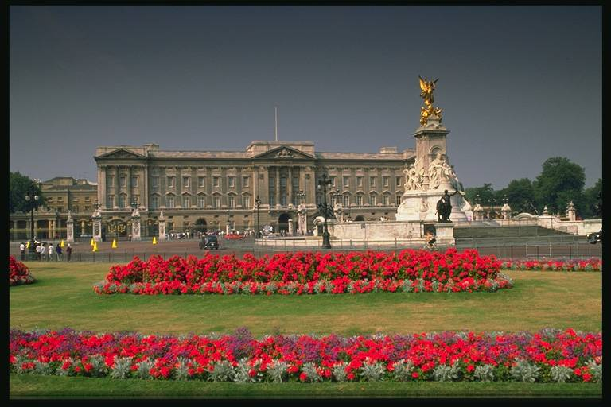
BUCKINGHAM PALACE

Slide 10
Buckingham palace
This is Buckingham Palace -
the place were British kings and queens live when they are in London.
Important visitors often go to the palace. They meet Queen Elizabeth and the royal family inside the palace.
A lot of tourist go to Buckingham Palace.
They stand outside and see the Changing of the Guard (смена караула)

Slide 11
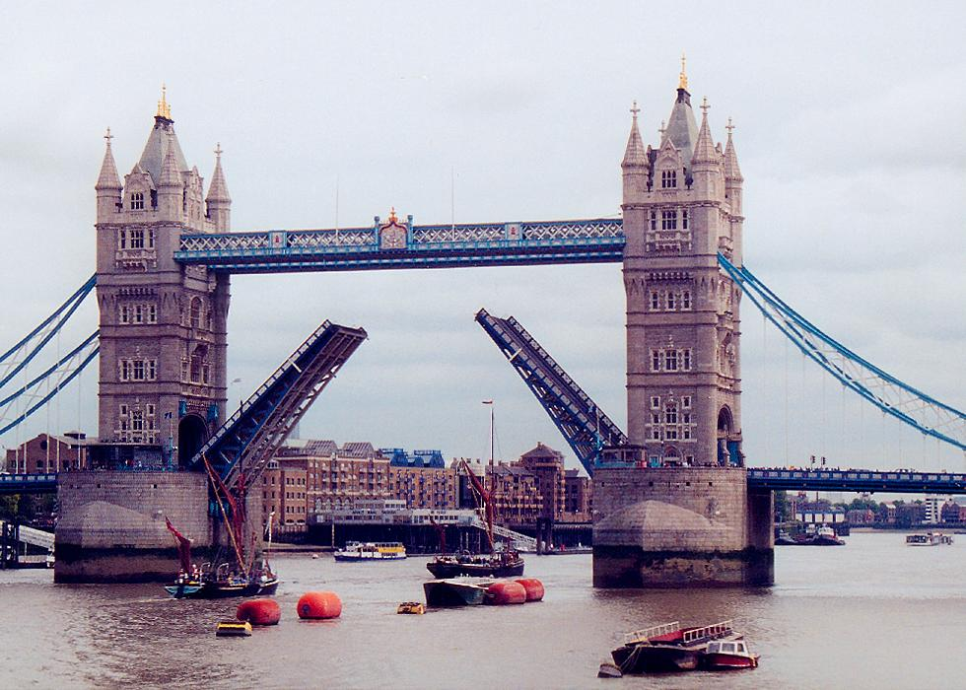
Scrambled letters
bebay
numontme
retteha
distamu
liaparmetn
umsemu
legalry
nemaic
aresqu

Slide 12
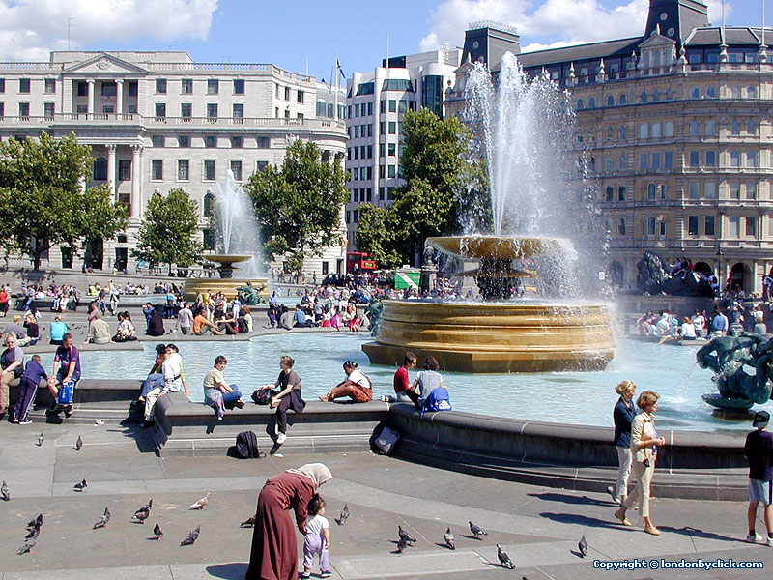
Check yourselVes
abbey
monument
theatre
stadium
parliament
museum
gallery
cinema
square

Slide 13
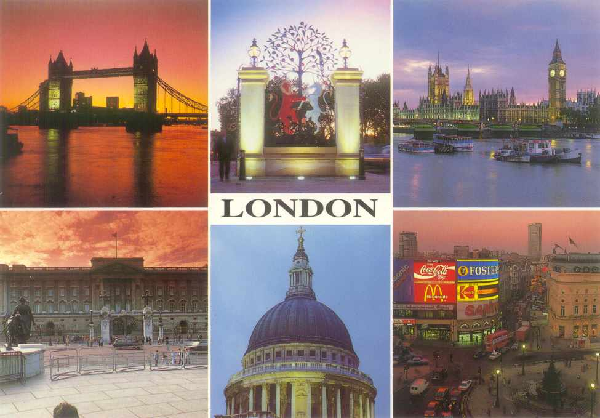
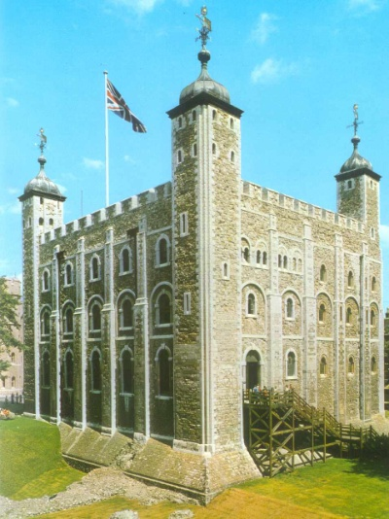
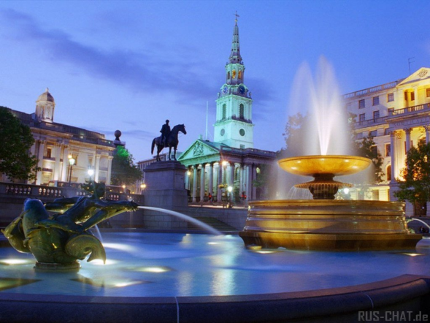
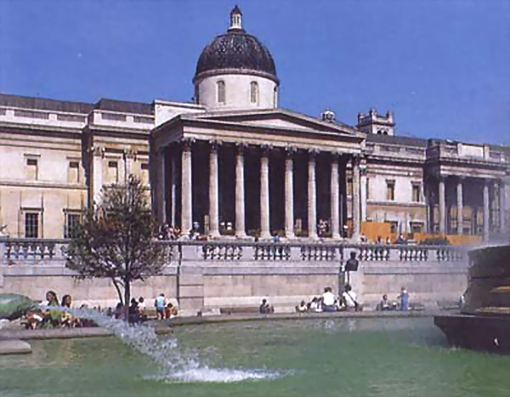
Match the parTS and read THEM ALOUD
The Tower of Palace
Trafalgar Parliament
St’Paul’s London
The National Ben
Buckingham Square
Westminster Gallery
The Houses of Cathedral
Big Abbey

Slide 14
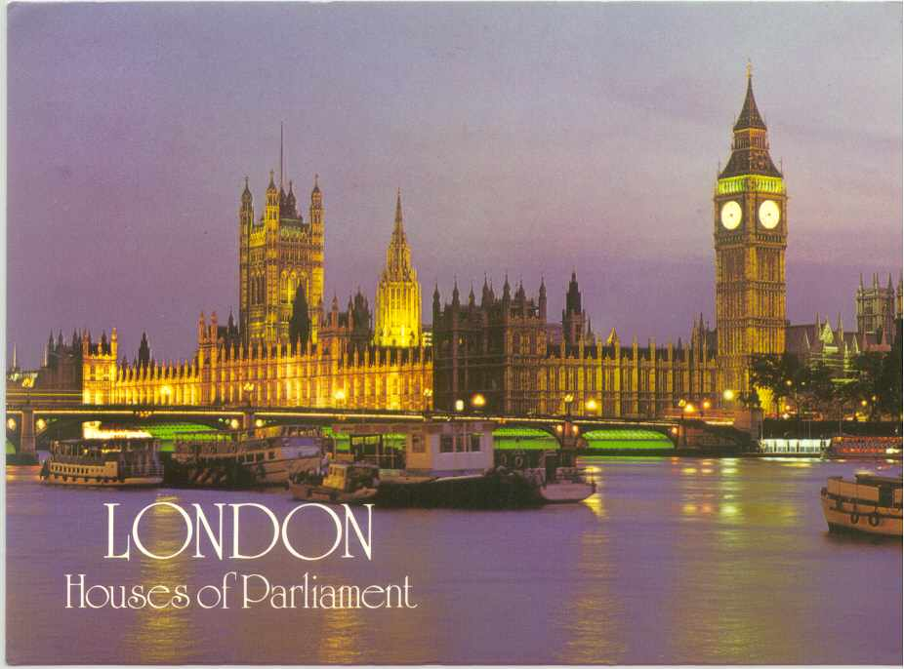
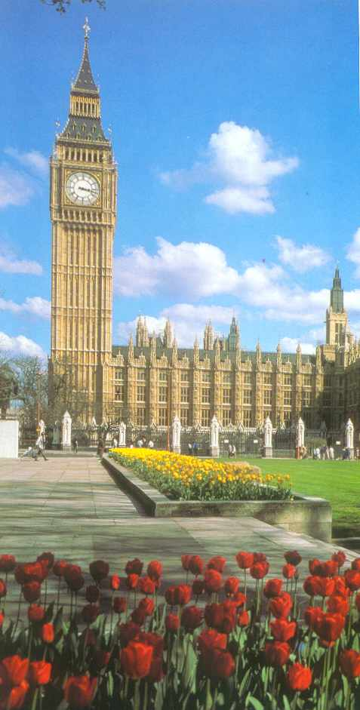
Check yourselves
The Tower of London
Trafalgar Square
St. Paul’s Cathedral
The National Gallery
Buckingham Palace
Westminster Abbey
The Houses of Parliament
Big Ben

Slide 15
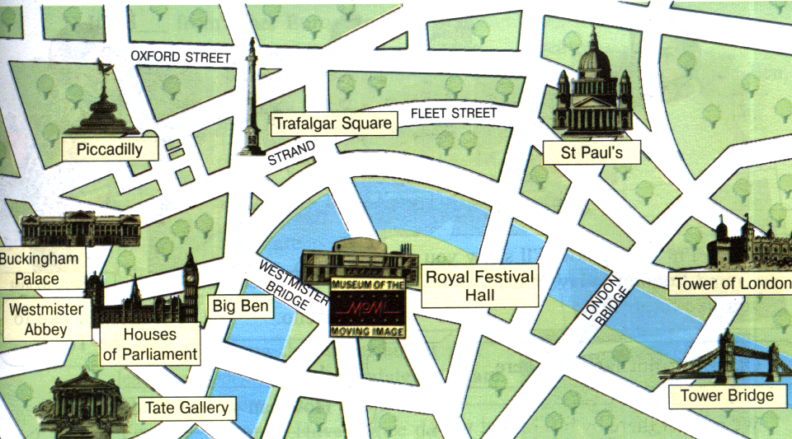
Look at the map of London. Find the places of interest you know and say a few words about them.

Slide 16
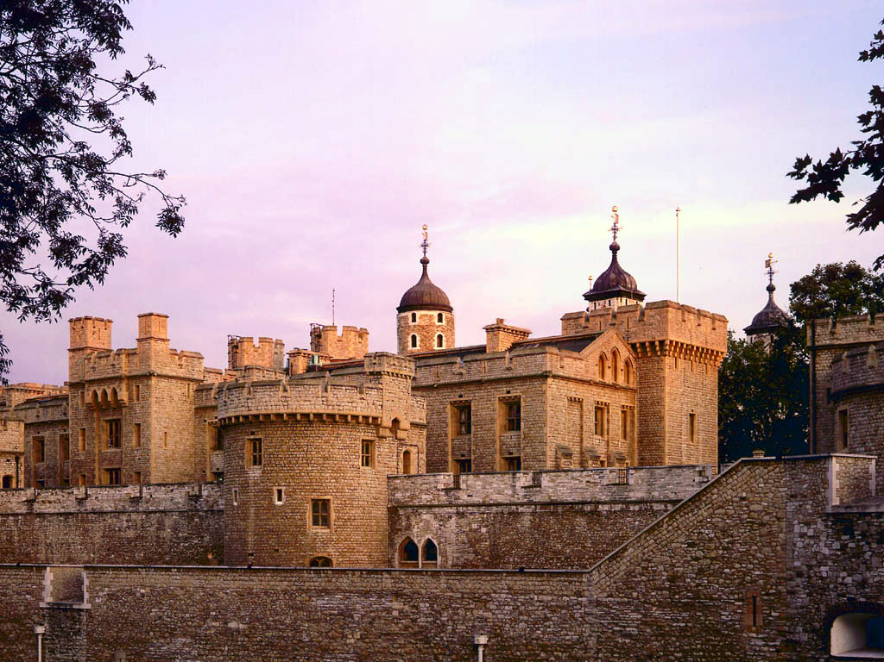

Slide 17
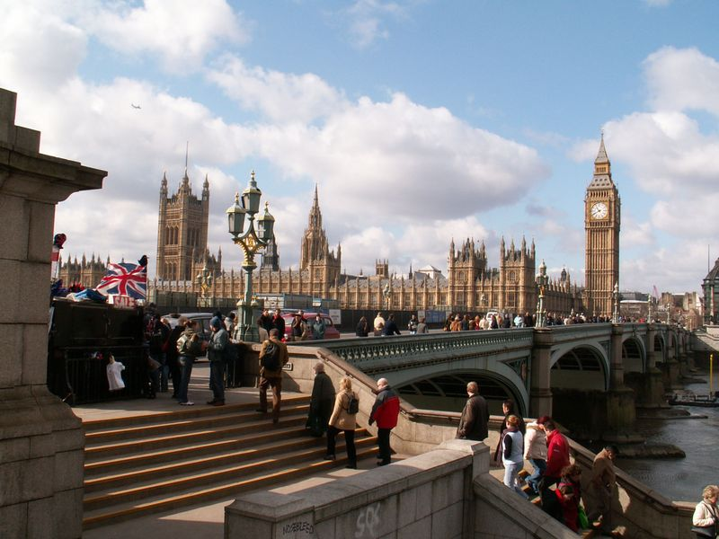

Slide 18
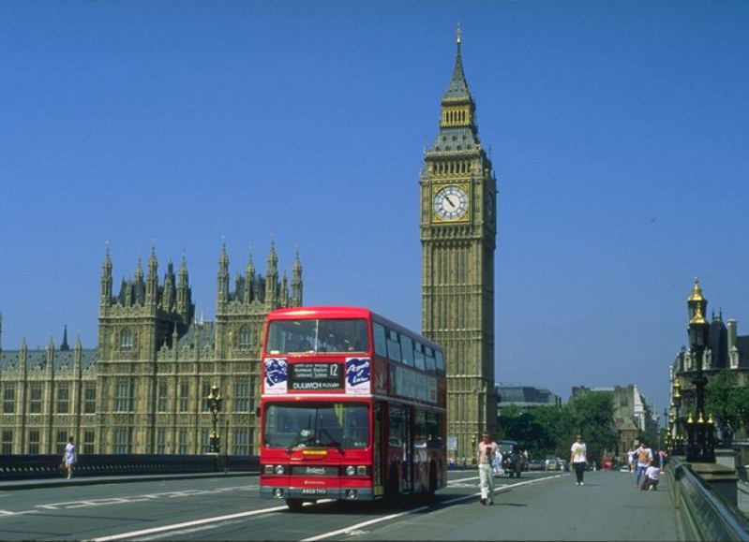

Slide 19
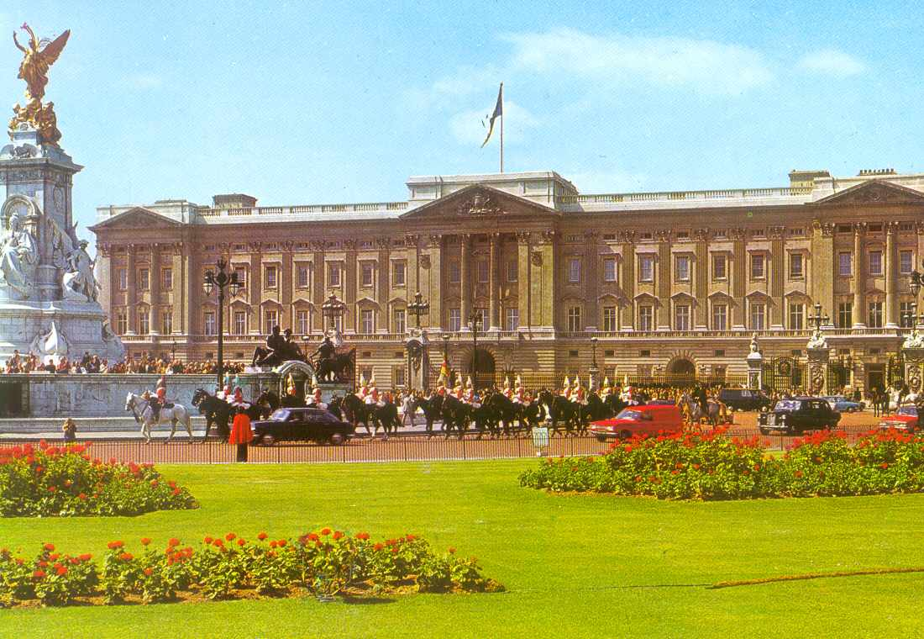

Slide 20
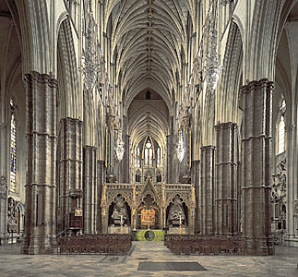
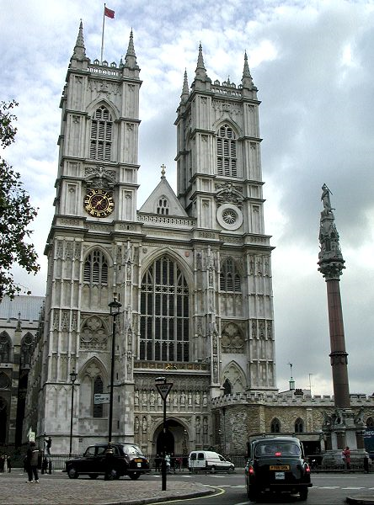
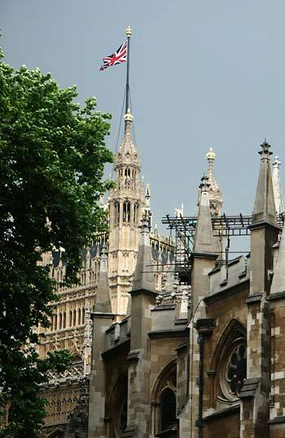

Slide 21
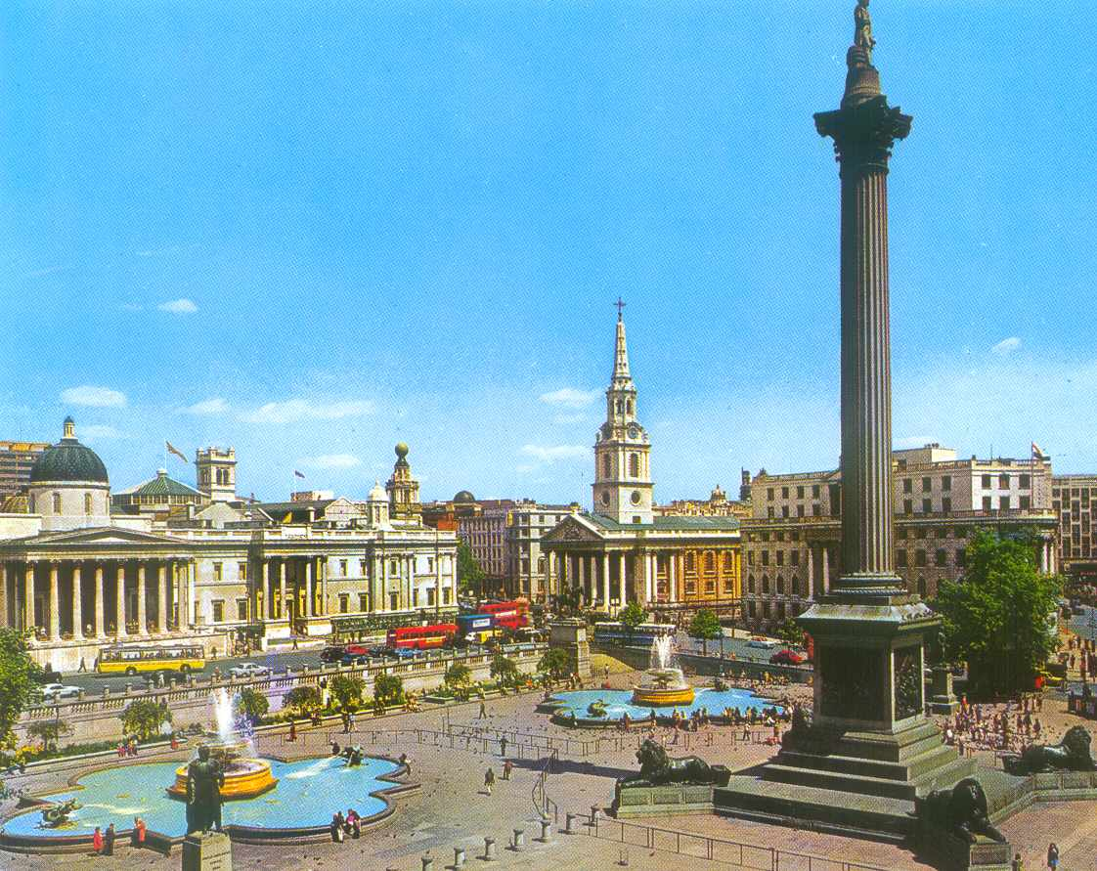

Slide 22
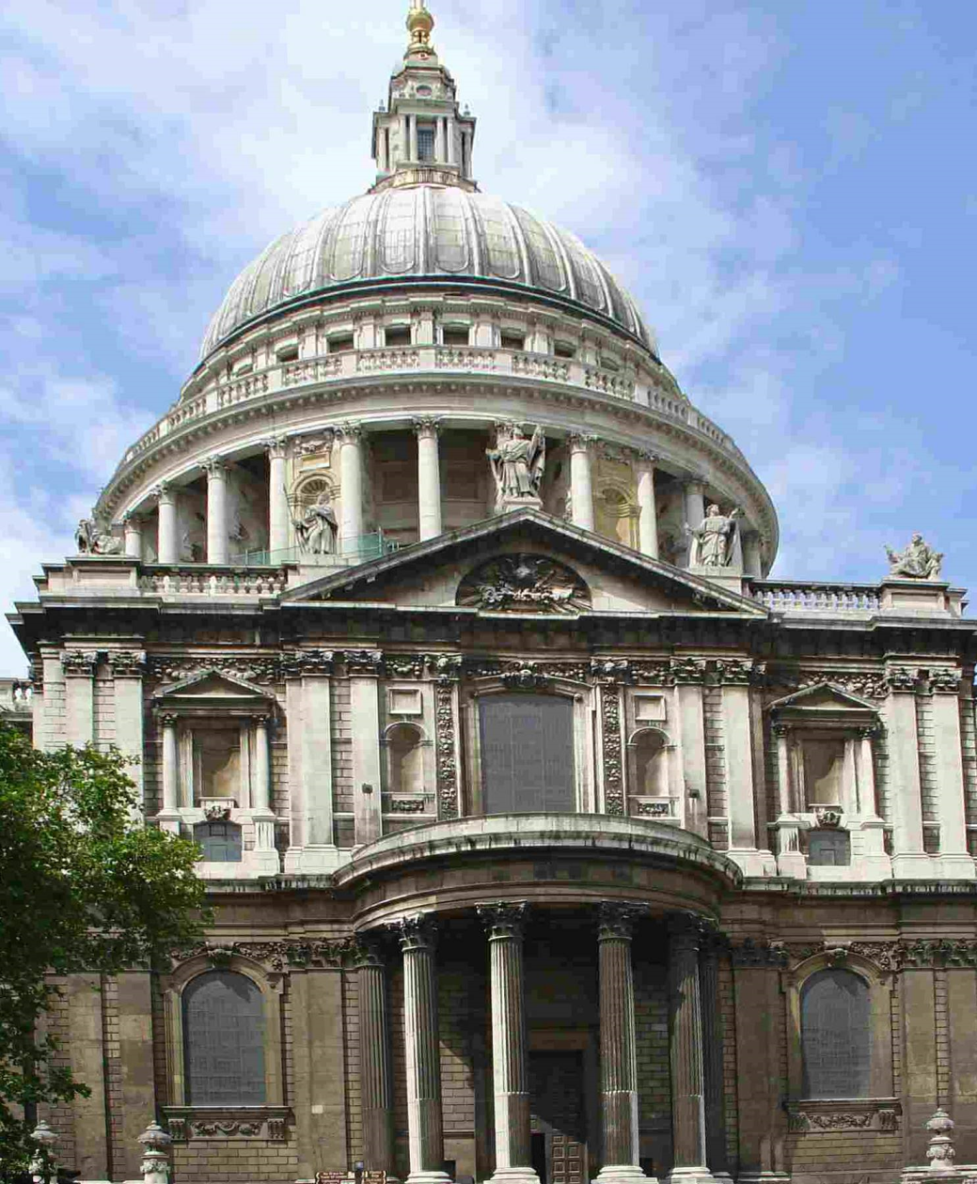
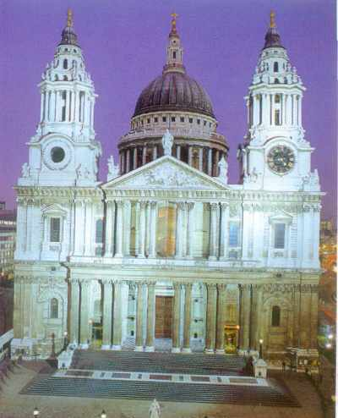

Slide 23
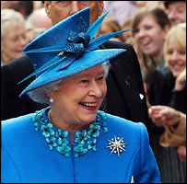
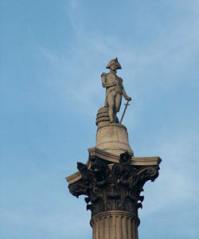
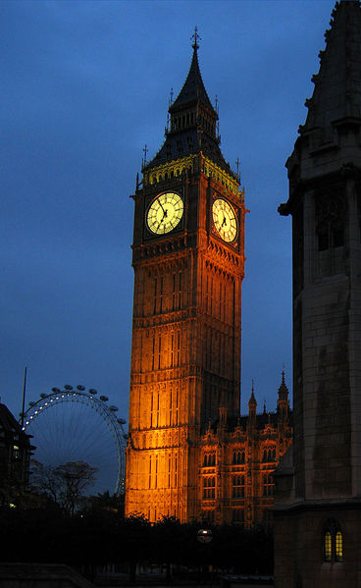
Do the crossword
1
2
5
4
3
8
7
6
1. In what Palace does the Queen live?
2. What is the Tower of London now?
3. What Abbey plays the role of the Royal church?
4. What square is situated in the geographical center of London?
5. In Trafalgar Square there is a monument to Admiral …
6. What is the most famous clock in Great Britain?
7. What gallery can you visit in Trafalgar Square?
8. What birds are the national symbol of London?

Slide 24
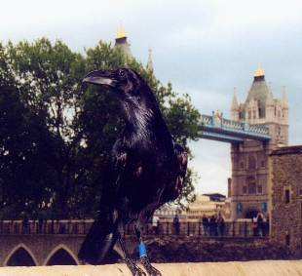
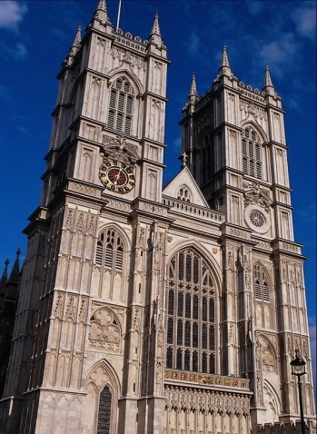
1
B
Check yourselves
2
m
u
s
e
u
m
c
5
N
k
4
T
3
W
e
s
t
m
i
n
s
t
e
r
l
n
a
s
g
f
8
r
o
h
a
7
N
a
t
i
o
n
a
l
a
l
v
m
6
B
i
g
B
e
n
e
a
n
r
s
1. In what Palace does the Queen live?
2. What is the Tower of London now?
3. What Abbey plays the role of the Royal church?
4. What square is situated in geographical center of London?
5. In Trafalgar Square there is a monument to Admiral …
6. What is the most famous clock in Great Britain?
7. What gallery can you visit in Trafalgar Square?
8. What birds are the national symbol of London?

Slide 25
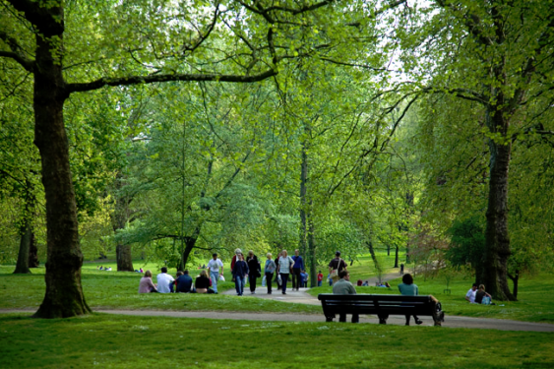
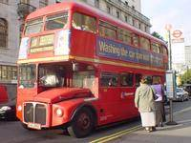
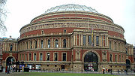
put in the missing words and Tell about your trip
London is the … of Great Britain. It is a very … city. It was founded about two thousand … ago. London is one of the most … and interesting … in Europe. There are ... … to visit in London. There are a lot of …, art …, cinemas, theatres and … parks in London.
cities, capital, places, museums, years, old, many, galleries, beautiful, important

Slide 26
Check yourselves
London is the capital of Great Britain. It is a very
old city. It was founded about two thousand years
ago. London is one of the most important
and interesting cities in Europe. There are many
places to visit in London. There are a lot of
museums, art galleries, cinemas, theatres and
beautiful parks in London.

Slide 27

Quiz: choose the right variant
1. London is the capital of___________
a)France b) England c) Scotland
2. The central part is_____________
а)Westminster b) Whitehall c) the City
3. London’s main shopping centre is________
a) Oxford Street b) Downing Street c) Parliament Square
4. William the Conqueror built the Tower of London in___
a) the 10th century b)the 11th century c) the 12th century
5. ____lives at number 10 Downing Street.
a) The British Prime Minister b) The Queen c) Admiral Nelson

Slide 28
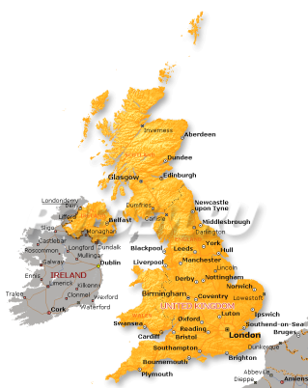
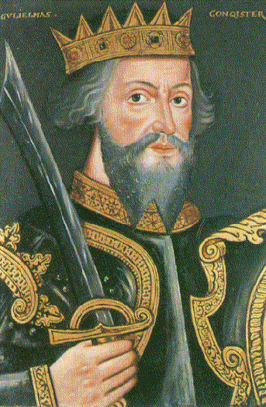
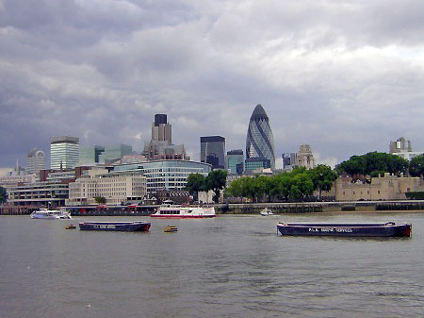
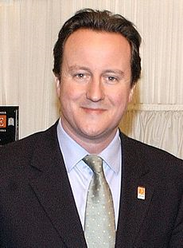
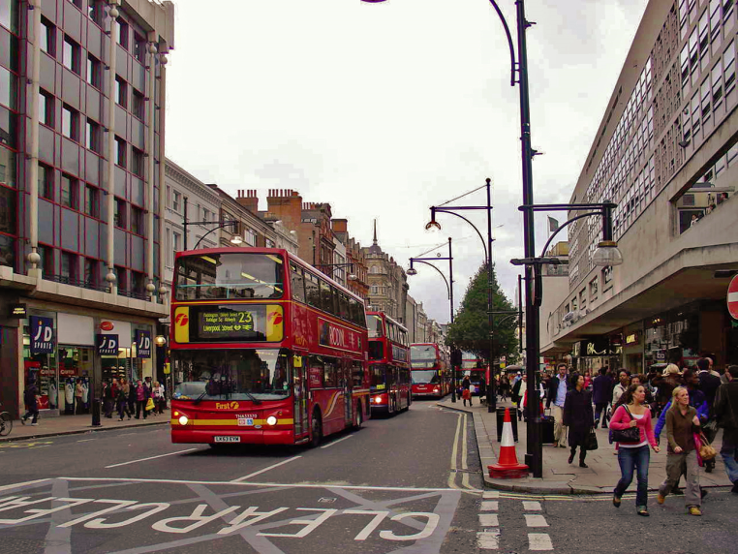
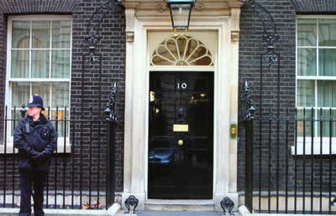
Check yourselves
1. b)
2. c)
3. a)
4. b)
5. a)

